Slide 1
Test Types Booking.com: Online Booking app
Mariia Kryzhalko
January 2016

Slide 2
Agenda
Smoke testing
Functional testing
Positive testing
Negative testing
Non-functional testing
Usability testing
UI testing
Internationalization testing
Performance testing
Load & Stress testing

Slide 3
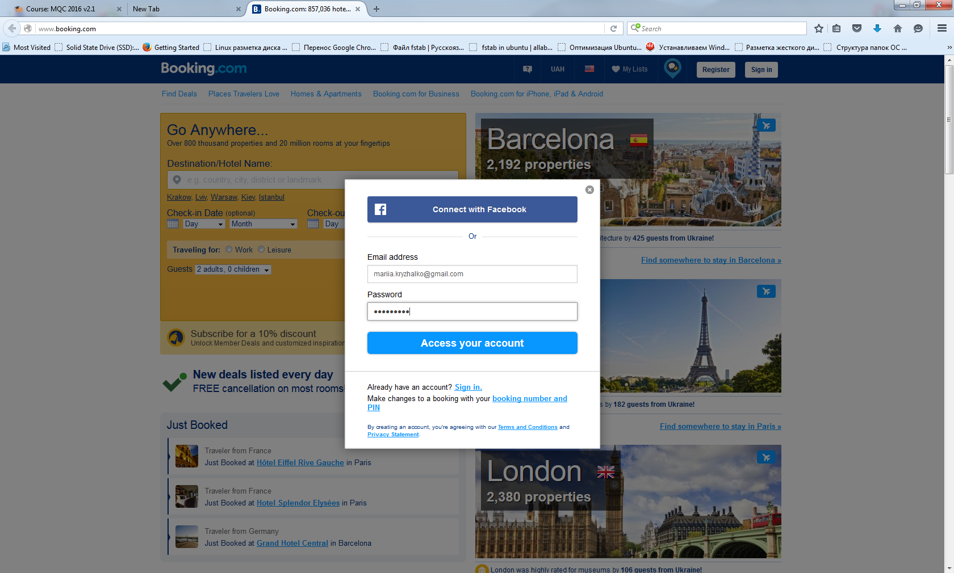
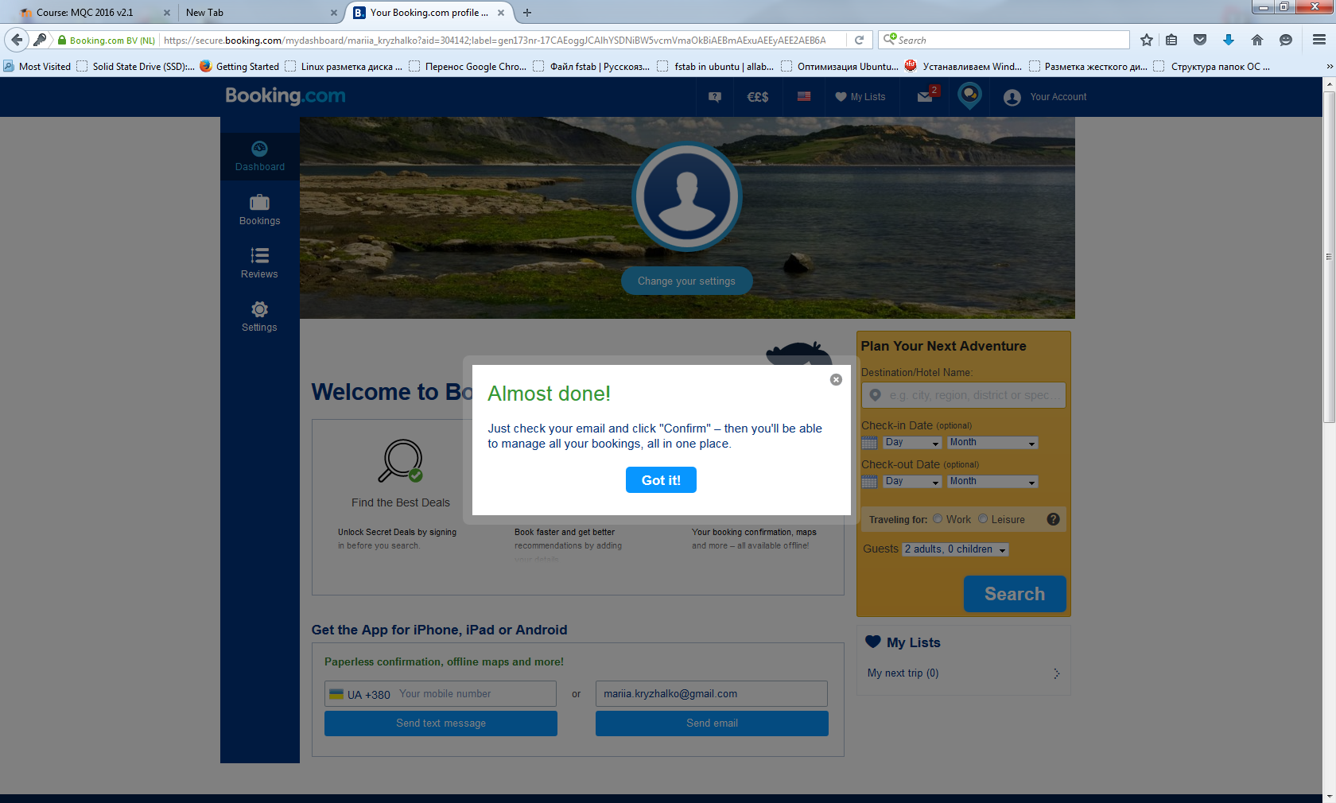
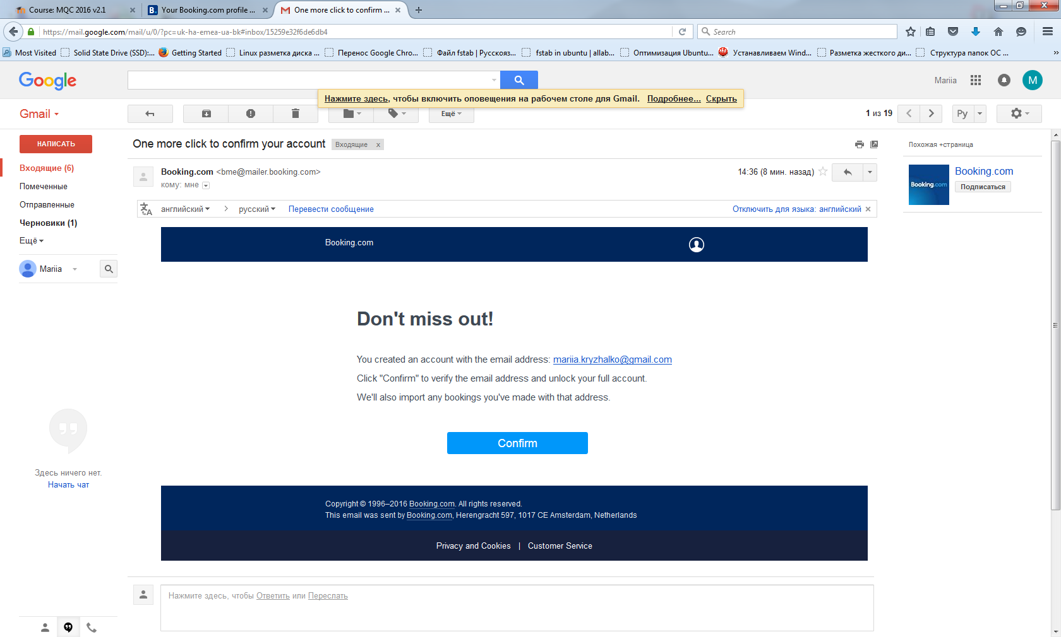
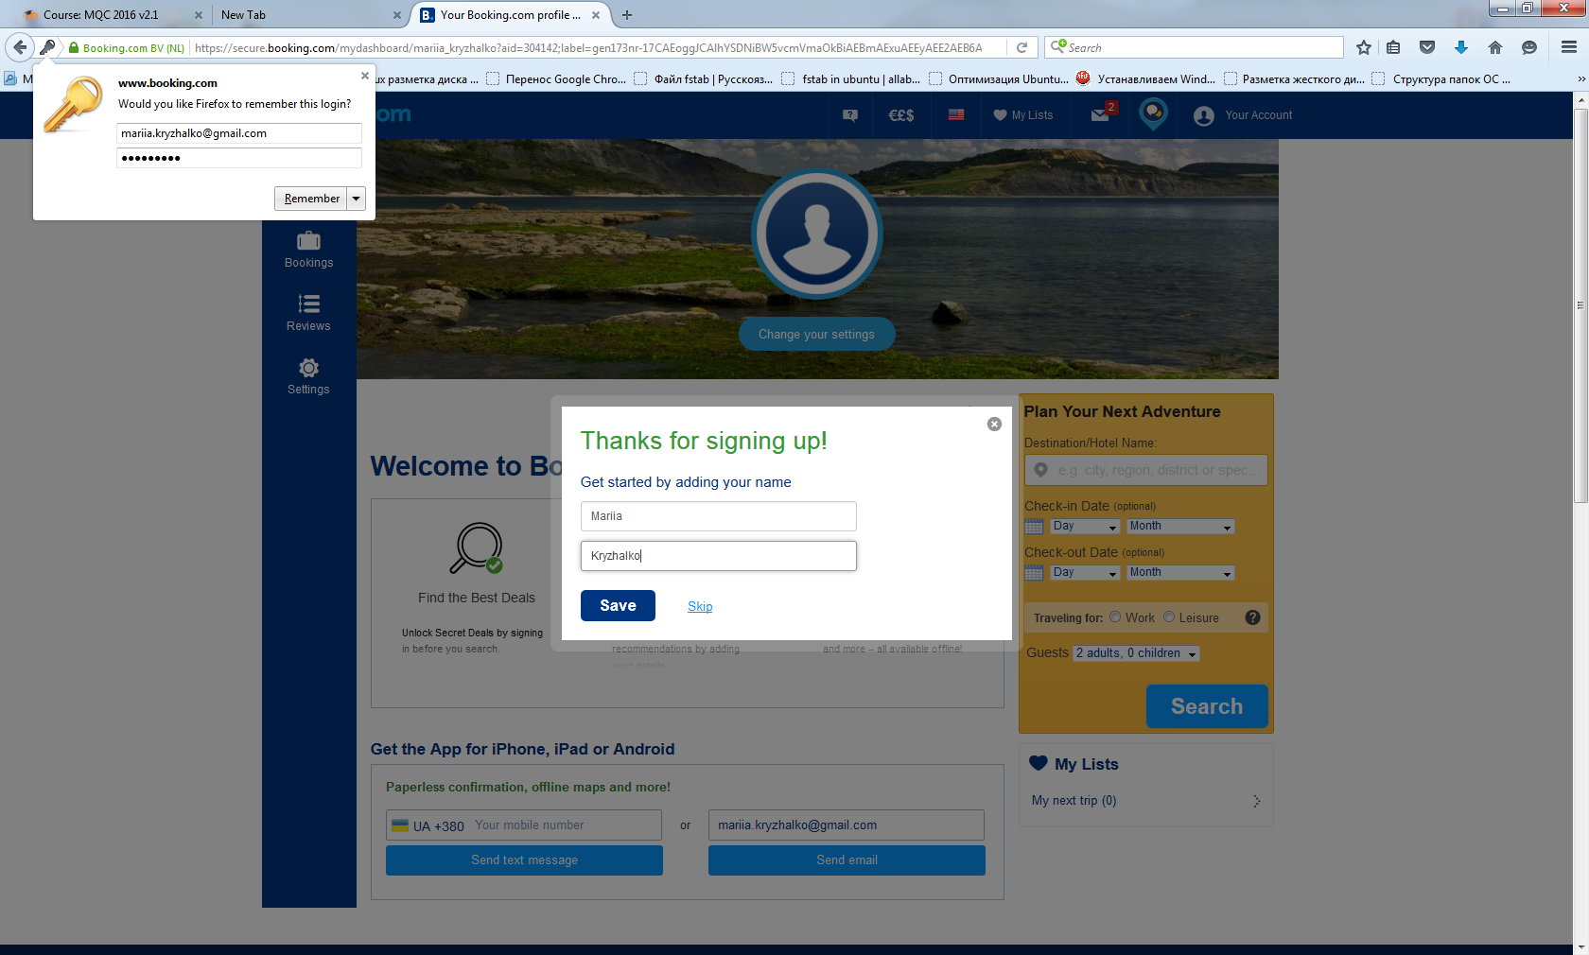
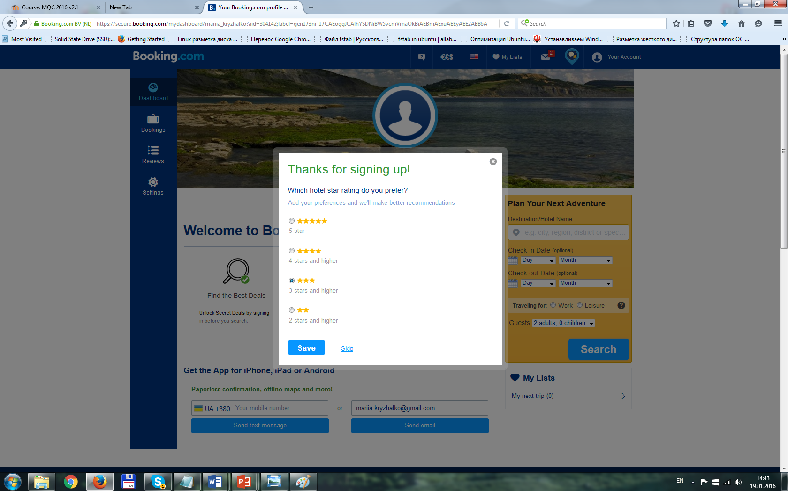
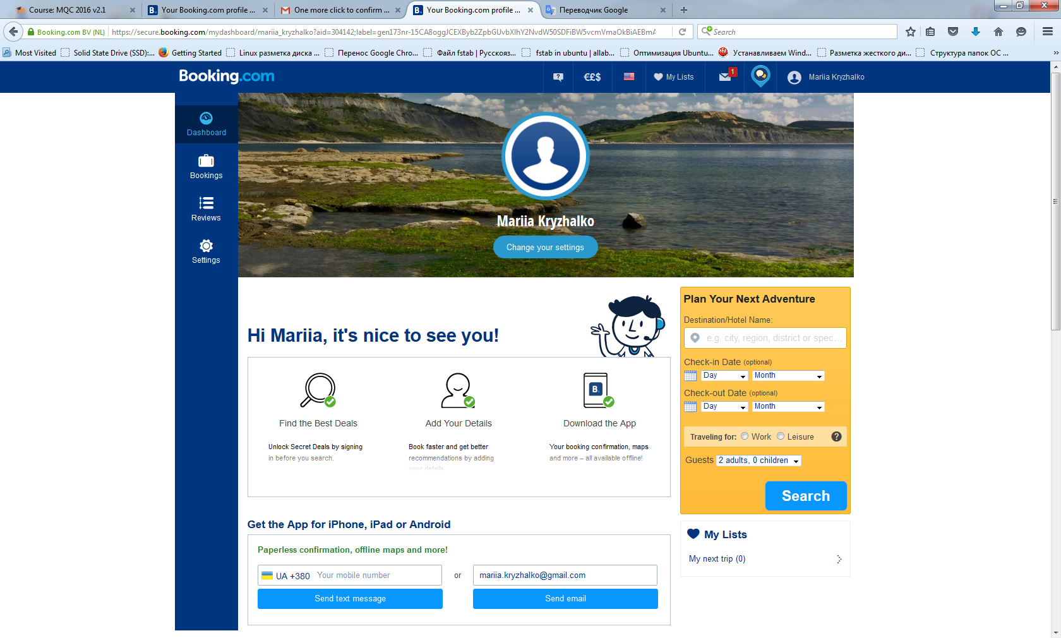
Smoke testing
Task: Test registration feature of Booking.com application
Requirements: Every user who wants to sign up into the Booking.com system should perform registration procedure and enter correct data into corresponding registration forms.
Smoke Testing Procedure:
1. Open URL Booking.com
2. Click button ‘Register’ in right top corner
3. Registration dialog window appears. Enter data into text boxes: ‘Email address’ and ‘Password’
4. Click ‘Access your account’ button
5. ‘Thanks for signing up!’ form opens. Enter name and surname into text boxes
6. Click ‘Save’ button
7. Choose one radio button in group box
8. Click ‘Save’ button
9. Click ‘Got it!’ button in next appeared window
10. Go to email and click “Confirm” in letter
11. Link direct you to your account in the Booking.com system
Expected result: Account is created. User is able to log in to the Booking.com system.

Slide 4
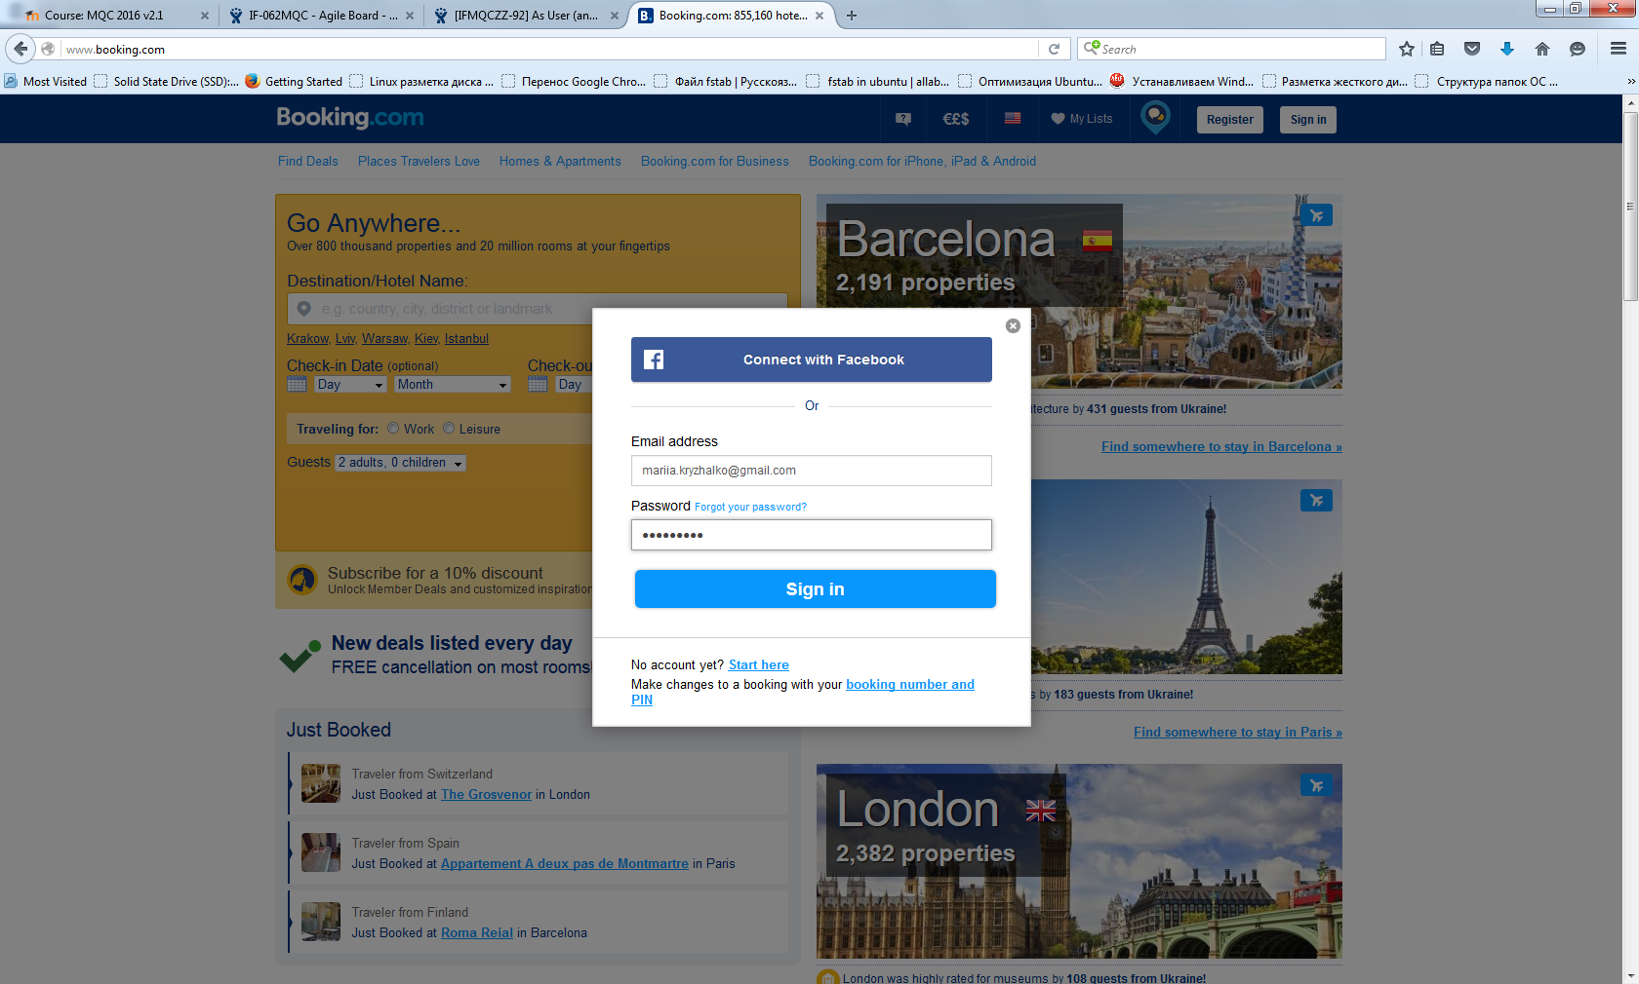
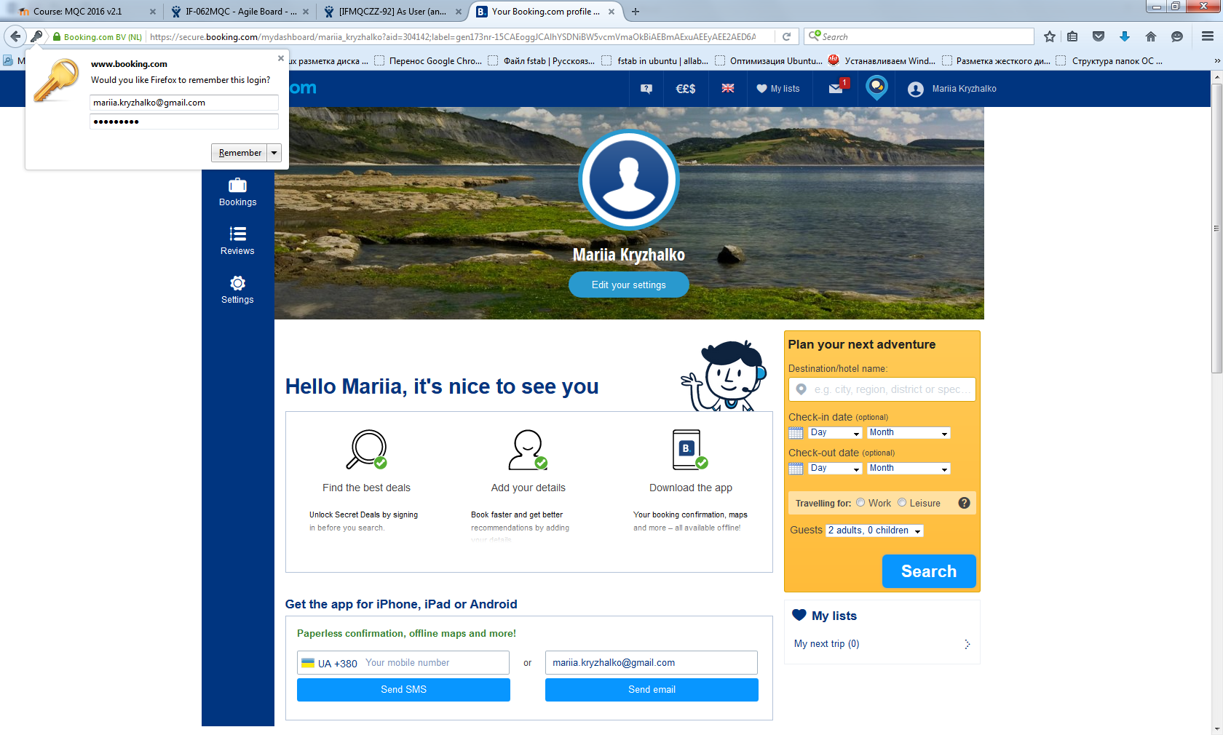
Functional testing
Task: Test ‘Log in’ feature of Booking.com application.
Requirements: Every registered user can log in the system by entering correct ‘Email address’ and ‘Password’.
Testing Procedure:
1. Open URL Booking.com
2. Click button ‘Sign in’ in right top corner
3. ‘Log in’ dialog window appears. Enter data into text boxes: ‘Email address’ and ‘Password’
4. Click ‘Sign in’ button
Expected result: User is directed to his account page in the Booking.com system.

Slide 5
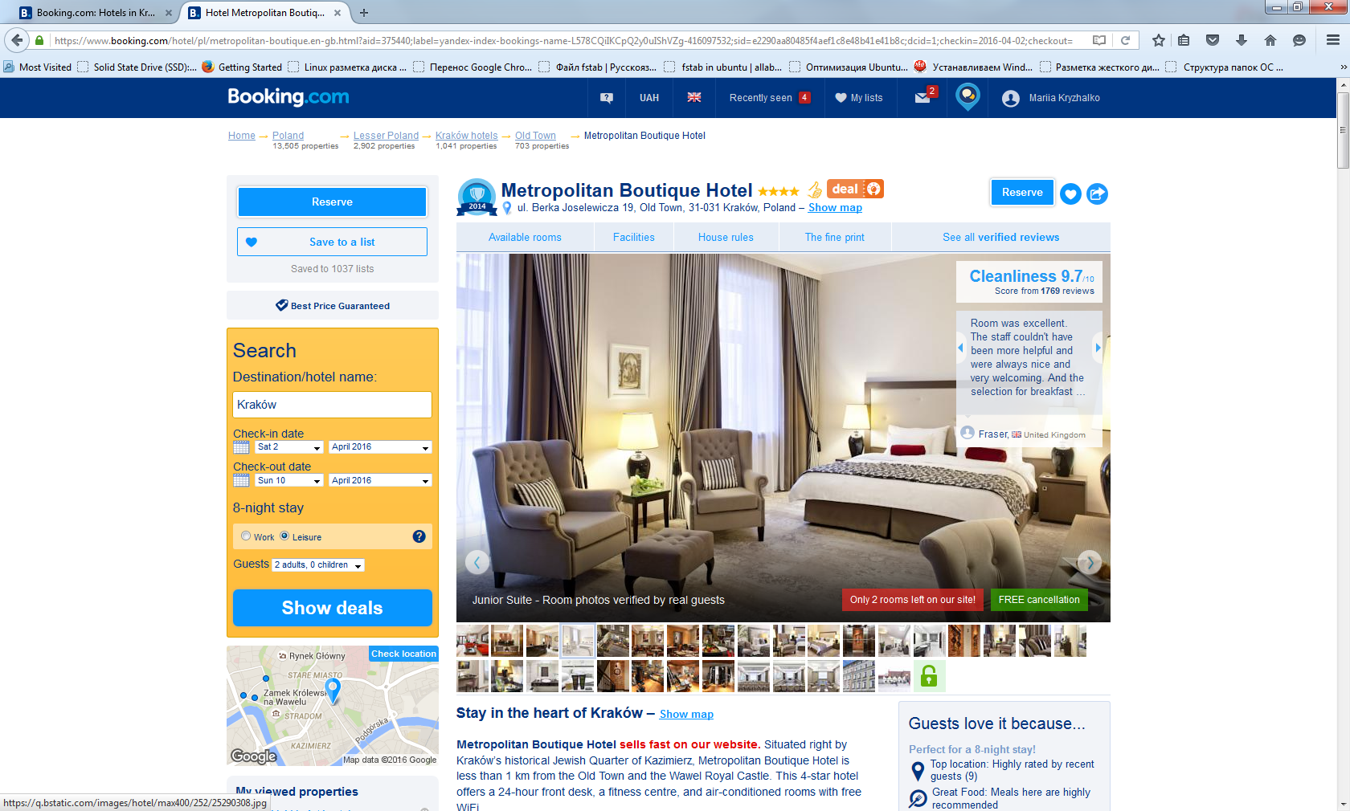
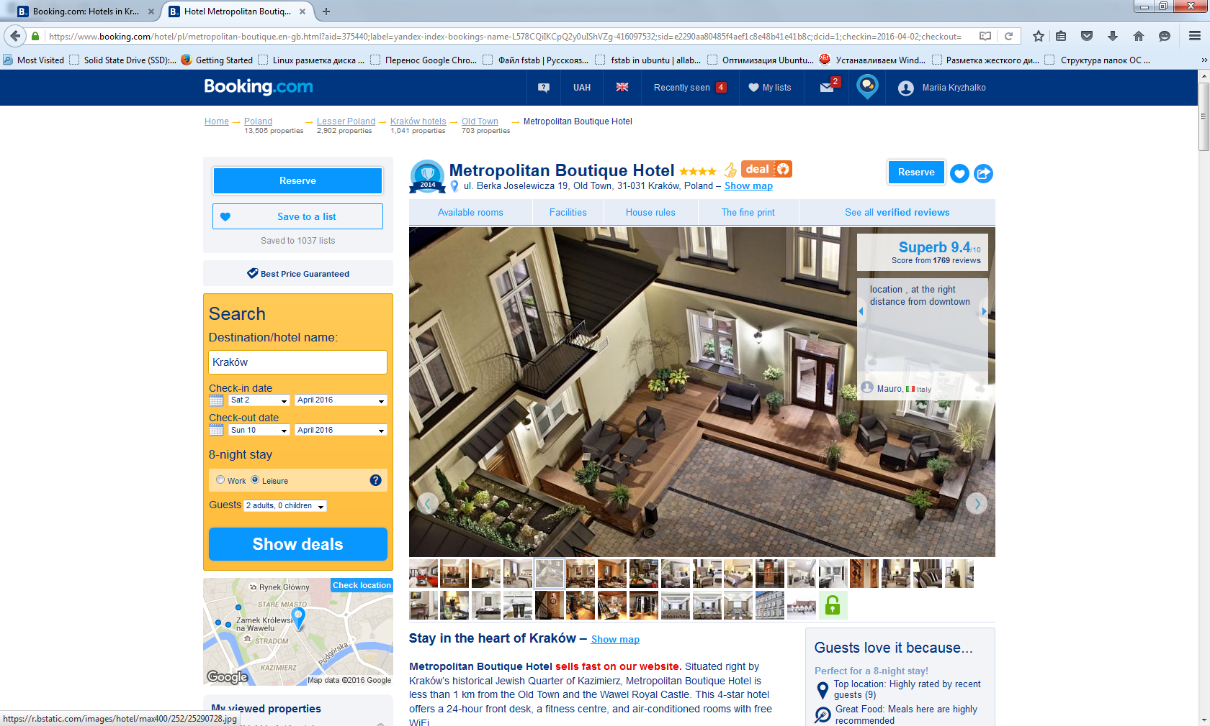
Positive testing
Task: Verify that hotels photos changed by clicking arrow icon on photo.
Requirements: User can switch hotels photos by clicking arrow icon on photo.
Testing Procedure:
1. Open URL Booking.com
2. Log in, go to ‘Plan your next adventure’ form on dashboard of users account page
3. Enter hotels name in search field, click ‘Search’ button
4. Go to hotels photo review
5. Click arrow icon on photo
Expected result: First photo is changed by next one.

Slide 6
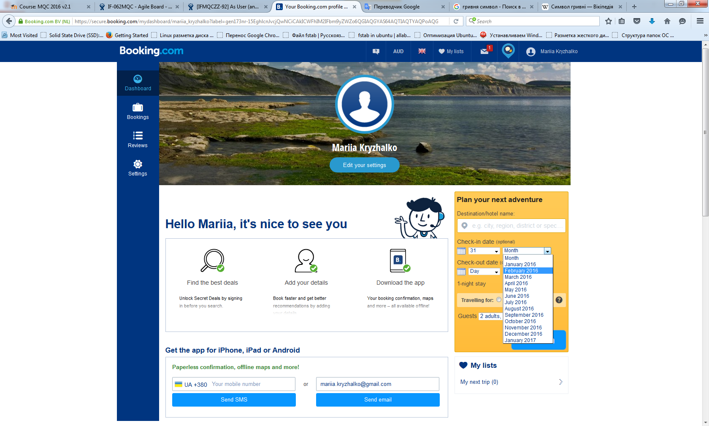

Negative testing
Task: Test datepicker feature behavior when incorrect date and month combination selected.
Requirements: When user selected incorrect date and month combination system should not accept it and cancel selection.
Testing Procedure:
1. Open URL Booking.com
2. Log in, go to ‘Plan your next adventure’ form on dashboard of users account page
3. In datepicker dropdown boxes select: ‘Day’ – 31 and ‘Month’ – ‘February 2016’
Expected result: Previously selected value in ‘Day’ dropdown box is canceled. There are 29 days in datepicker ‘Day’ dropdown box.

Slide 7
Non-functional testing
Task: Test if system contains any spelling mistakes.
Requirements: Booking.com application does not contain spelling mistakes.
Testing Procedure:
1. Open URL Booking.com
2. Click button ‘Register’ in right top corner
3. Registration dialog window appears. Enter data into text boxes: ‘Email address’ and ‘Password’
4. Click ‘Access your account’ button
5. ‘Thanks for signing up!’ form opens. Enter name and surname into text boxes
6. Click ‘Save’ button
7. Group box of four radio buttons appears
8. Observe
Expected result: Label of first radio button is ‘5 stars’ - plural.
Defect: Label of first radio button is ‘5 star’ – singular.

Slide 8
Usability testing
Task: Test if system contains unclear elements for users.
Requirements: Booking.com application is easy to use, handling controls is easily understood.
Testing Procedure:
1. Open URL Booking.com
2. Click button ‘Register’ in right top corner
3. Registration dialog window appears. Enter data into text boxes: ‘Email address’ and ‘Password’
4. Click ‘Access your account’ button
5. ‘Thanks for signing up!’ form opens
6. Observe
Expected result: There are following labels for text boxes: ‘First Name’, Last Name’.
Defect: There is no labels for text boxes. User does not understand what exactly should he enter into boxes.

Slide 9
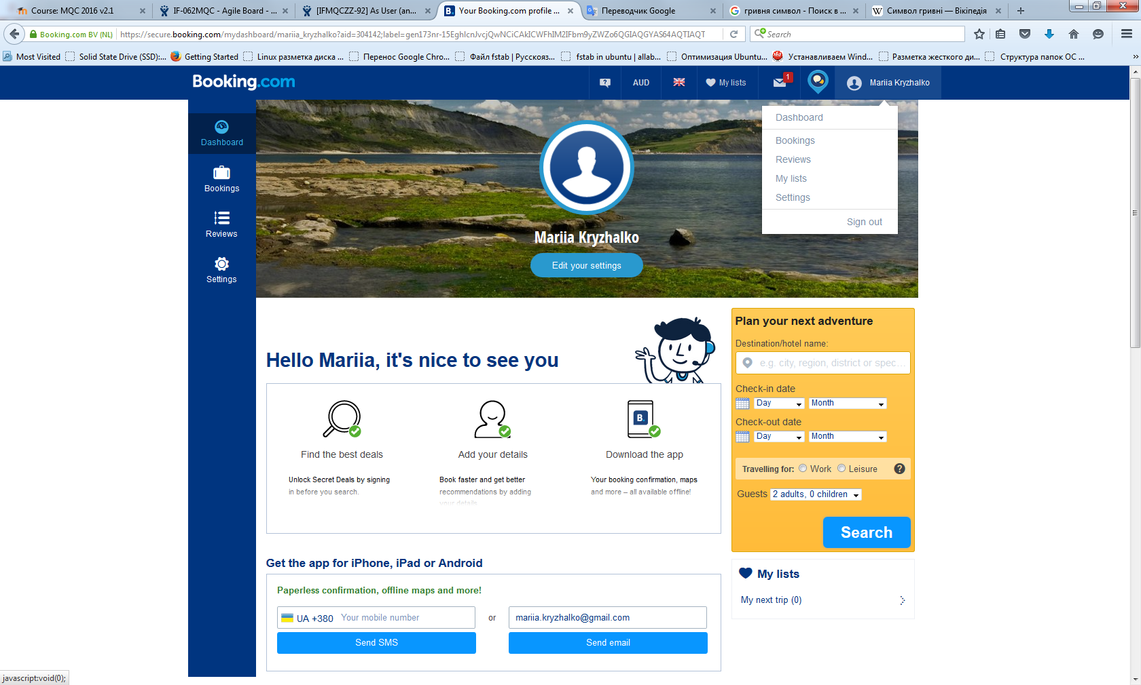
UI testing
Task: Test if Tabs navigational control corresponds its discription.
Requirements: There is vertical Tabs navigational control on left side of account page. It consists of four tabs: Dashboard(default), Bookings, Reviews, Settings.
Testing Procedure:
1. Open URL Booking.com
2. Log in
3. Observe
Expected result: Tabs navigational control corresponds its discription.

Slide 10
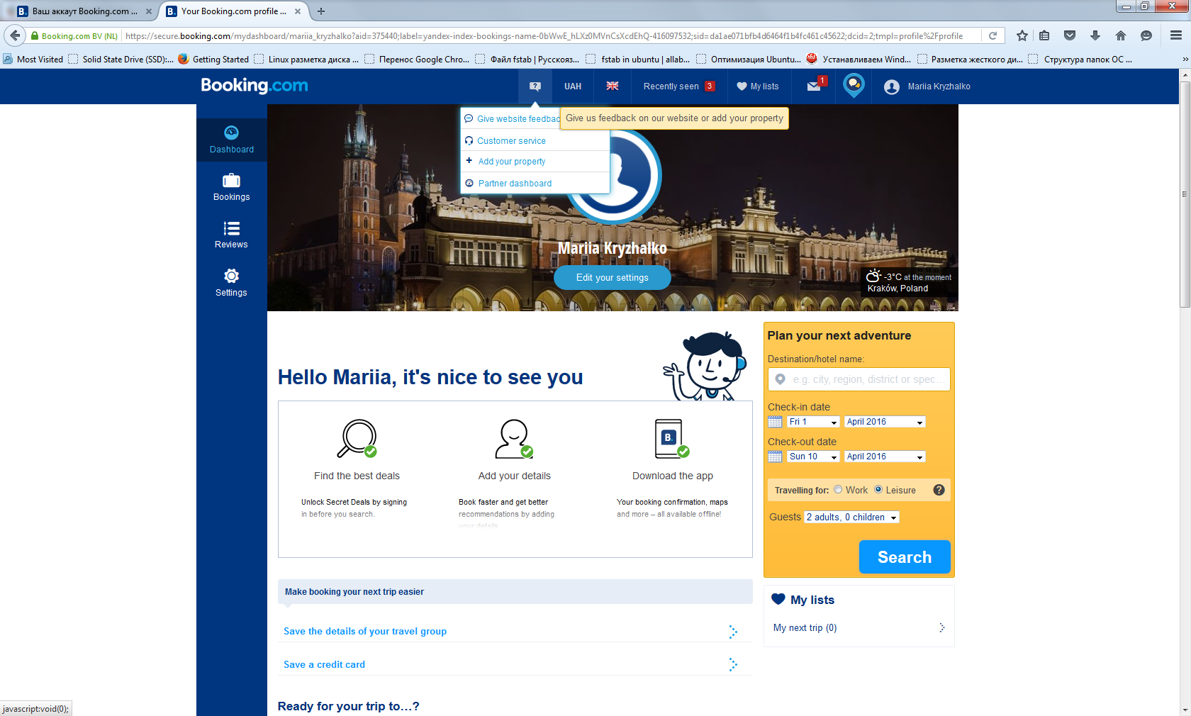
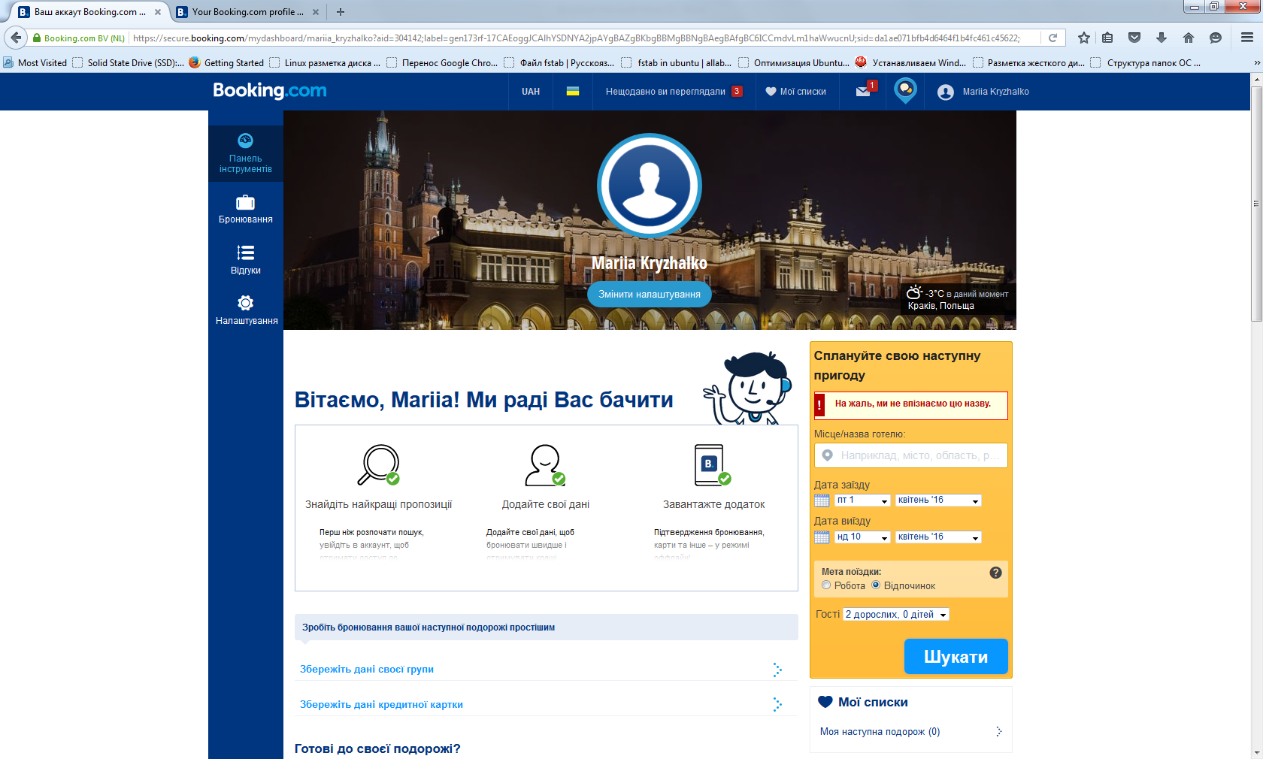
Internationalization testing
Task: Verify that menu title on top of account page is the same for each language.
Requirements: Booking.com system includes the translation of the application user interface into 42 languages. For each language user interface view is the same (contains the same UI elements etc.)
Testing Procedure:
1. Open URL Booking.com
2. Sign in the application
3. Observe menu title on top of account page
4. Change language into Ukrainian
5. Observe menu title on top of account page
Expected result: Menu title on top of account page is the same for Ukrainian language as for English language. Menu title consists of the same set of menu items.
Defect: Menu title on top of account page when English language chosen contains menu item that give user ability to give feedback on website or add properties. In Ukrainian version this menu item is absent.

Slide 11
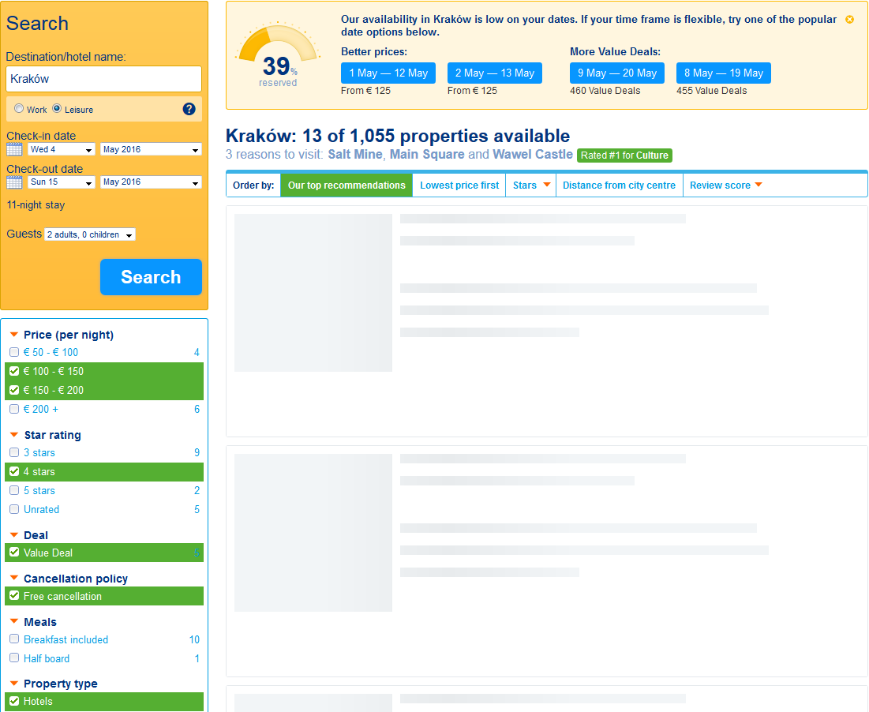
Performance testing
Task: Test Booking.com filter feature performance.
Requirements: Website should respond in less than 2 sec after user has mark items in filter.
Testing Procedure:
1. Open URL Booking.com
2. Log in, go to ‘Search’ form
3. Mark some items in filter
4. Observe
Expected result: Filter results is shown in 2 sec
Defect: Filter results is shown in 4 sec

Slide 12
Load & Stress testing
Task: Server should allow up to 10 000 concurrent connections.
1. Load Testing Procedure: emulate different amount of requests to server close to pick value, for instance, measure time for 8000, 9500, 10 000 concurrent users.
Expected result: Server should not crash up to 10 000 concurrent connections.
2. Stress Testing Procedure: emulate amount of requests to server greater than pick value, for instance, check system behavior for 10 001, 10 500, and 12 000 concurrent users.
Expected result: Server returns message “Request Time Out” starting from 10 001 concurrent requests.
Data should not be lost.

Slide 13
Thank you

